Slide 1
性能决定一切：9项关于消费者的关键认知
Notes:
Good afternoon folks and thank you for joining us on today for our webinar on the subject “Performance Matters”. During the course of this webinar we’ll jointly learn about some of the trends and challenges in delivering performance over the web and what you can do to solve these challenges.
So without further ado, lets get straight into it !!!

Slide 2





































Akamai的客户
Retail | Travel and Hospitality | Consumer Goods
96 out of US top 100 online retailers trust Akamai | 19 our of top 20 global hotel groups trust Akamai | 6 out of 8 biggest luxury brands trust Akamai
Notes:
Talking points:
You’re using Akamai every day, whether you’re downloading music, watching a video online, reading the news, checking Facebook, or buying a birthday present online. No one delivers more Web content than Akamai. In commerce specifically we have over 900 organizations -- including customers large and small using the Akamai platform. Akamai has become the fundamental platform for running eCommerce. We are so PERVASIVE in retail that we:
Deliver 40% of all online commerce
Touch 99% of all online shoppers every single day.
In fact 39 of the Internet Retailer Top 40 are Akamai customers -- and we deliver 250 of the IR Top 500.

Slide 3

日程
演讲者:
市场调查报告分享
挑战
解决方案
客户案例
李文涛
Product Marketing Manager,
Greater China, Akamai
Notes:
Let me begin by introducing myself. I am Srinivas Padmanabharao and I am a part of APJ team of Akamai Technologies. I am based in Bangalore.
Over the course of today’s webcast, I want to share with you four topics of information.
First, I will share with you the findings from a recent Global survey we did to understand consumer behaviour and expectations from their web experiences.
Second we’ll discuss what some of the underlying challenges are for organizations trying to deliver good experiences on the web…and that is pretty much everybody today, because the internet is a critical channel for business interactions – whether it be for commerce, customer support, brand building or enterprise productivity applications.
Third, I’ll share with you some ideas and thoughts on what we at Akamai, jointly with our partners Sify, offer to help you overcome these challenges as you plan your digital strategies for 2016.
Lastly, I’ll share some success stories of customers using some of these solutions and their experiences.
So lets get started !!!

Slide 4

Notes:
Now to set the context for the market research we did … look at this picture. Do you recognize this? <pause> I don’t. <pause> That is because, today nobody accesses the internet this way, not to mention works at an office this way. This was yesterday.
How do we do it today?

Slide 5






I want-to-do moments
I want-to-know moments
Web变得情景化！
I want-to-go moments
I want-to-buy moments
Notes:
This is a more representative of how we access the internet and conduct business & pleasure today. In airplanes, in coffee shops, in our bed, at the station, etc. <Click>
The web is today situational. What that means is that consumers expect predictable Experiences in Unpredictable Conditions at all times of the day and night and their use of the web is fragmented into moments. And your challenge as an organization is to deliver a consistently good experience at ALL those moments.

Slide 6
市场调查报告分享
Notes:
With that context, let me take you through what we found in our Global research on consumer behaviour and expectations.

Slide 7
“
开展市场调查
研究消费者行为
Notes:
In 2014, Akamai commissioned leading market research company TNS to conduct a follow up study identifying growth insights, preferences, trends in device usage and the impact of performance among financial services, and e-commerce consumers across the globe.

Slide 8
“
获得有关设备使用的喜好和趋势，以及性能对电商及金融服务的影响

Slide 9
两个主题
#1 性能决定一切
#2 Mobile is now
Notes:
We tried to answer the questions of “How important is performance?” and “Is the mobile revolution here?” through the course of our survey and the findings from our survey can be summarized along two key dimensions….#1 “Yes” Performance does matter & #2 “Yes” Mobile is now. And over these two themes we picked up about 9 key insights that I will now share with you.
<Click>
Let us start by looking at the importance of performance

Slide 10

＃1 性能决定一切
约50%的消费者希望页面加载能够在2秒以内完成

Slide 11
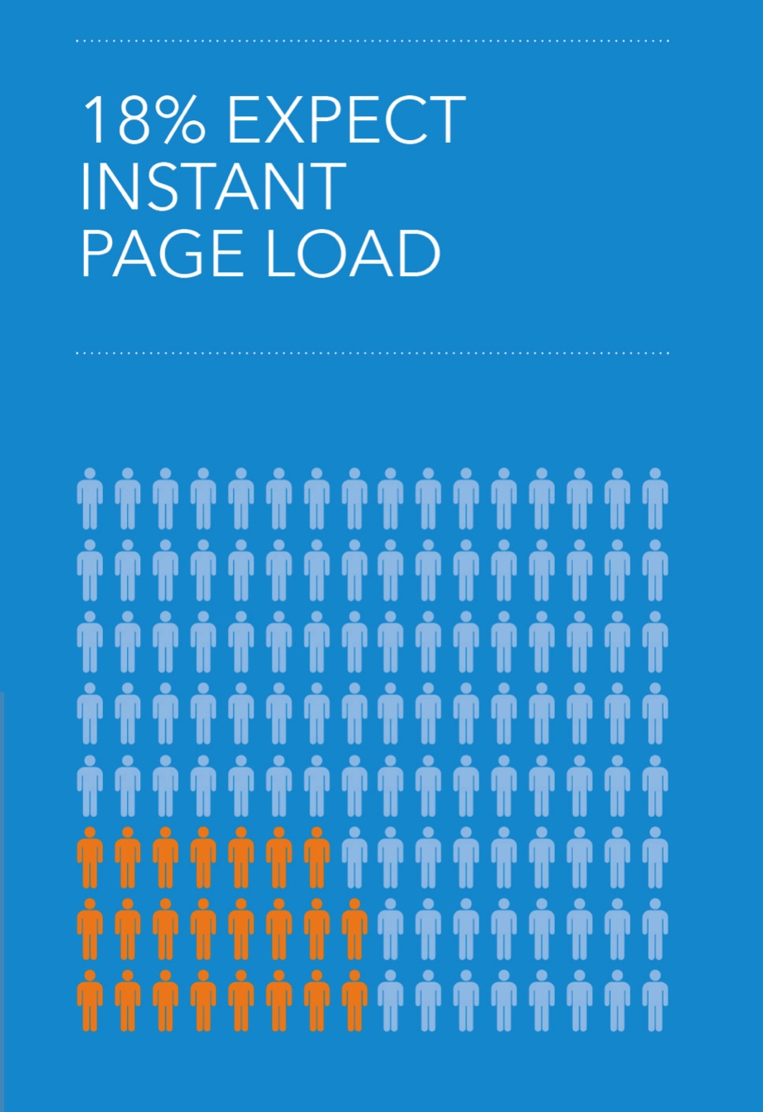
＃1 性能决定一切
近五分之一的消费者希望页面加载能立即完成

Slide 12
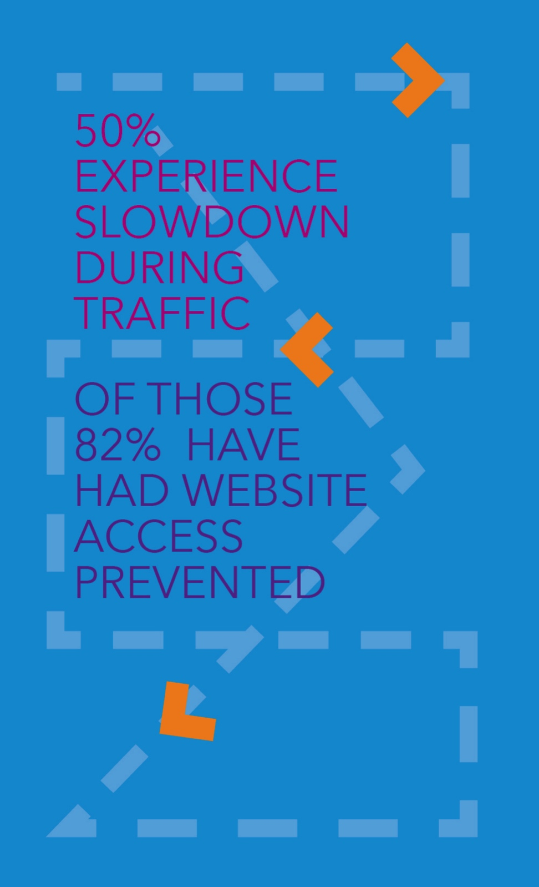
＃1 性能决定一切
50%的消费者曾经在高峰时段遭遇过性能问题

Slide 13
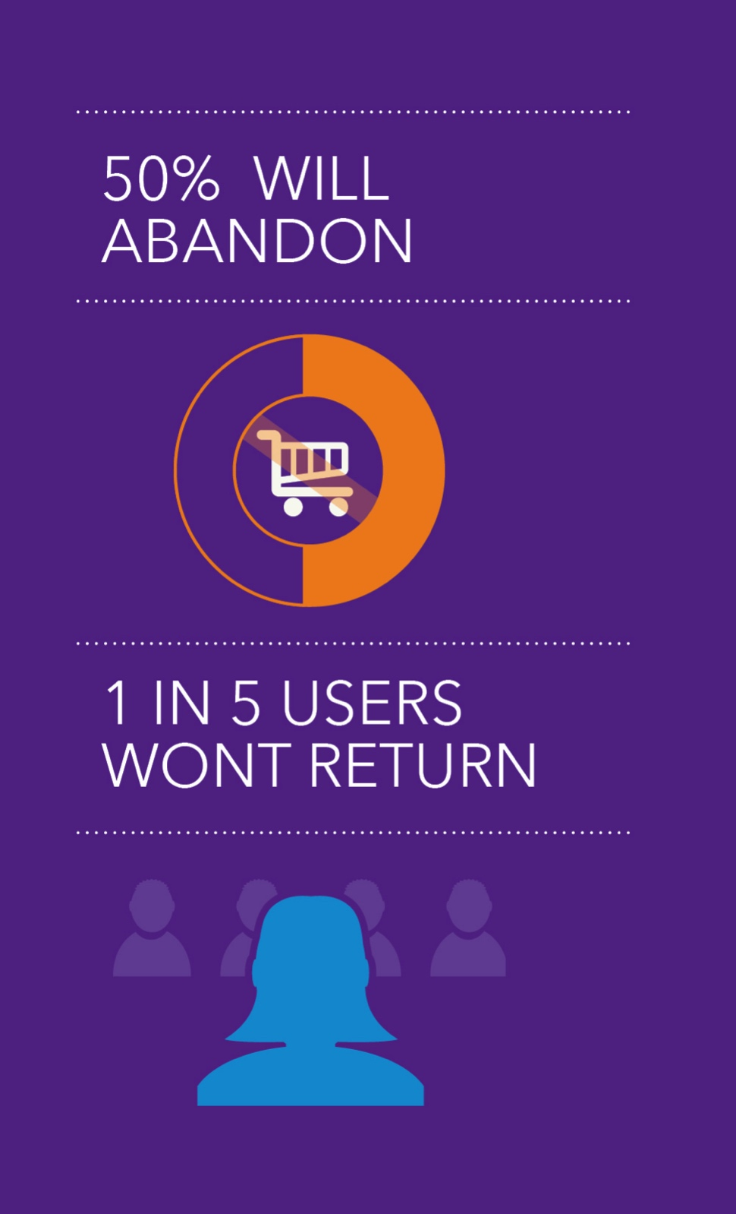
＃1 性能决定一切
如果购物者不开心，他们就会放弃访问站点，也不可能成为回头客

Slide 14
加载缓慢的页面 = 放弃购买
Notes:
Trying to find one we had not used in a webinar yet – so if you have a better image or stat that’s great
http://apmblog.dynatrace.com/2013/09/11/with-confidence-into-the-holiday-season-verifying-readiness-in-test-pre-production/
http://cartrescuer.com/blog/2014/04/07/how-slow-load-times-can-impact-shopping-cart-abandonment/

Slide 15
Two main themes
#1 Performance Matters
#2 移动化就在眼前
Notes:
Now moving on the second set of findings from the survey “Mobile is now”

Slide 16
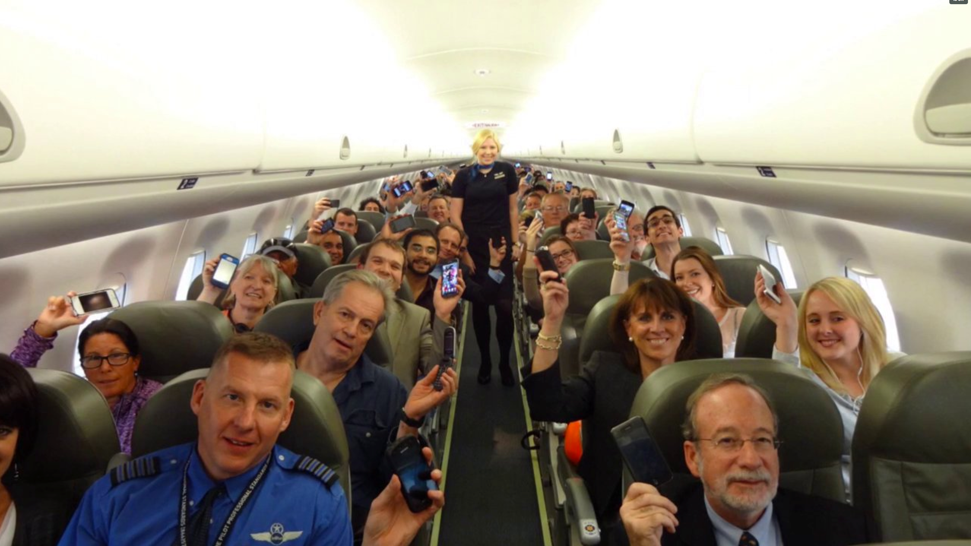
Everyone loves Mobile!
Notes:
First of all – it should not come as a secret to anybody that EVERYONE loves mobile…the growth of smartphones and tablets is proof enough that our desires are not satisfied on this front.
Did you know that in India – 65% of internet traffic is from mobile devices? That should give you some cause to think on why everybody is talking mobile apps and mobile web today.

Slide 17
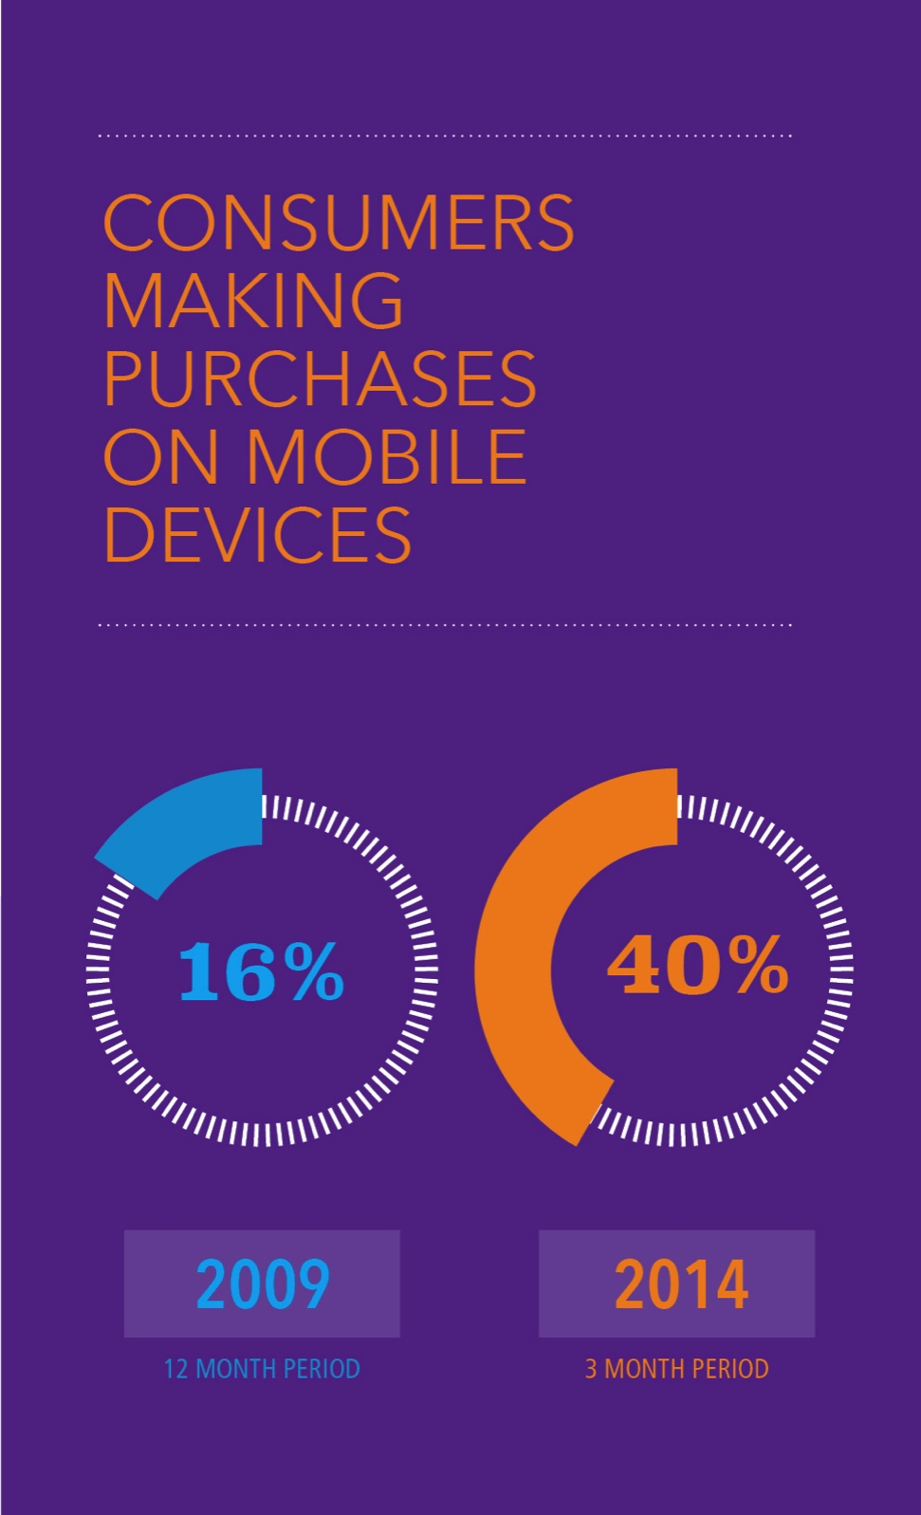
＃2 移动化就在眼前
通过手机进行采购的用户数量增加了2.5倍

Slide 18
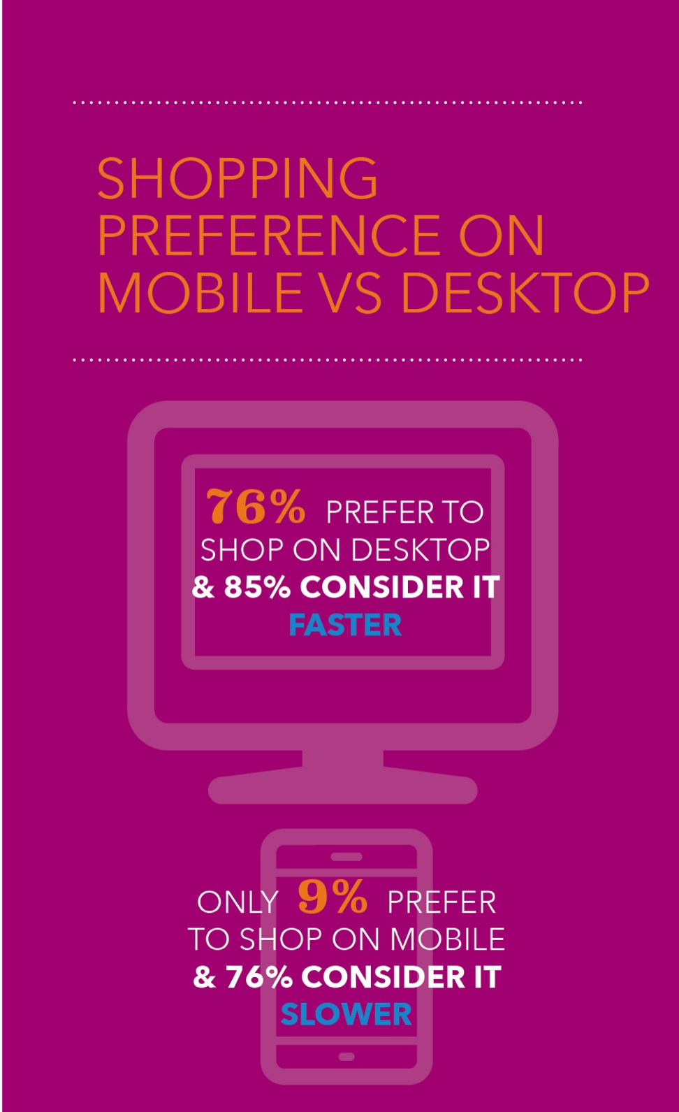
＃2 移动化就在眼前
手机被认为是消费体验满意度最低的方式

Slide 19
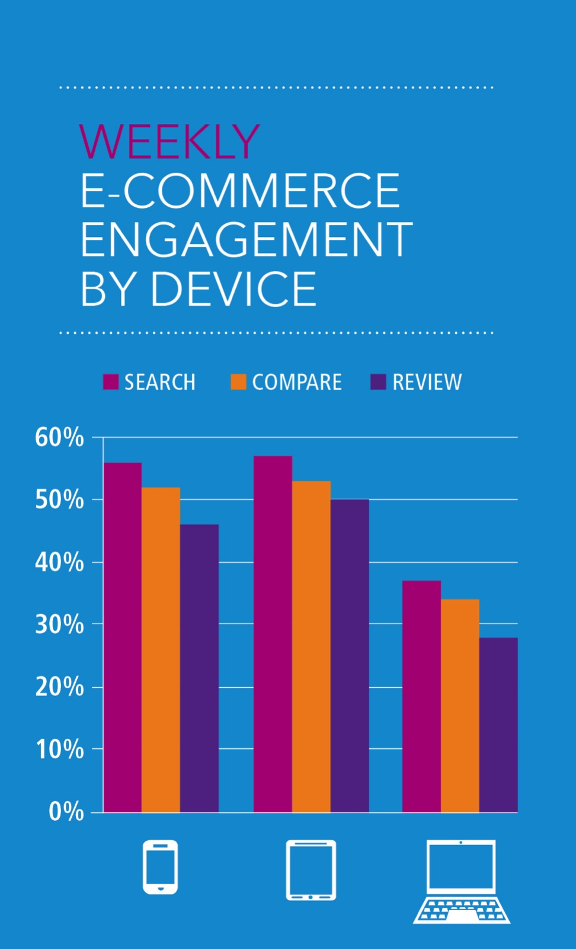
＃2 移动化就在眼前
手机和平板电脑用户的交互程度最高

Slide 20
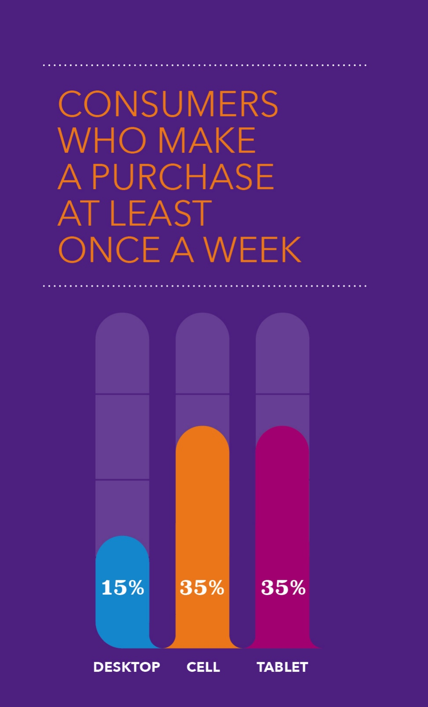
＃2 移动化就在眼前
对于经常网购的顾客，使用手机和平板电脑的购买频率比使用电脑的用户高。
Notes:
Jason – to address your concern, we can address slide 19 in the powerpoint presentation (which I will send along to you).

Slide 21
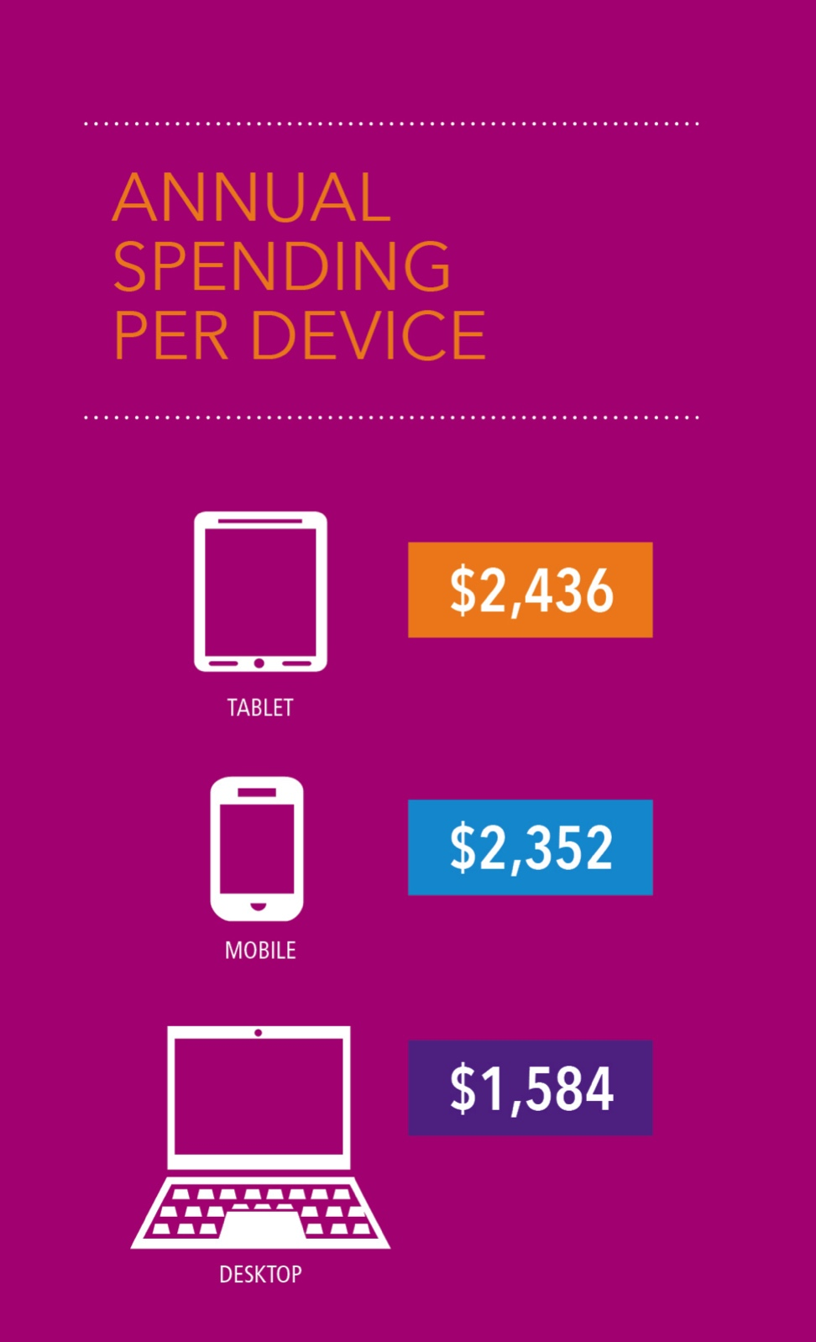
2) 移动化就在眼前
对于经常网购的用户，在手机和平板电脑上比PC上花更多的钱
Notes:
Reference point is slide 21 in the powerpoint

Slide 22
响应式的设计（RWD）
Notes:
Over 18K different form factors of Androids
RWD helps to future proof site for new device form factors

Slide 23
挑战
Notes:
So, in summary the Global research shows Performance does matter !!! And if you want to engage shoppers and customers – Mobile is a must NOW !!!
What then are the underlying challenges in doing this….lets dig a little deeper !!!

Slide 24
挑战1:Web页面的大小在不断增长
在2014年7月，排名前1000的网站的页面大小已经达到了1600K。
Notes:
http://www.websiteoptimization.com/speed/tweak/average-web-page/ - Do we have similar data we could use that’s our own?

Slide 25
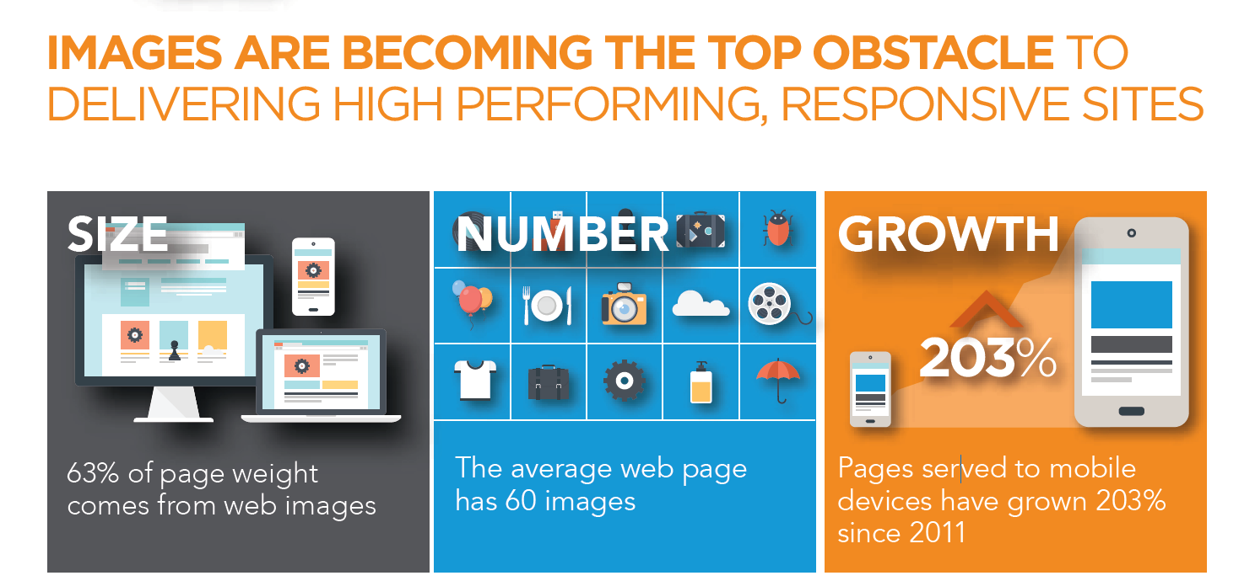
挑战 #2 : 图片管理和优化成为关键
Notes:
1.5 Trillion Images Daily (excludes favicon.ico! / includes Jpg/Png/gif)
30% Growth YoY( up from 1.1 Trillion in 2014 )
1.2 Billion images per day from Image Converter
54% smaller, on average than original image
39 TeraBytes served each day
Could have been 99TB /day
Saving end users from downloading 60 TeraBytes each day
Average transformed size is 31KB
848 Million AIC transformations each day
33% from mobile
67% from desktops
33% smaller file size than original
17 Terabytes of images served each day
Could have been 67 TB /day
Saving end users from downloading 49 TeraBytes each day
Average transformed size is 13.7KB
Source: Akamai Platform

Slide 26




挑战 #3 : RWD并不是完整的移动解决方案
分析471个RWD站点，针对不同设备的页面内容下载
726 KB
755
KB
813 KB
818 KB

Slide 27
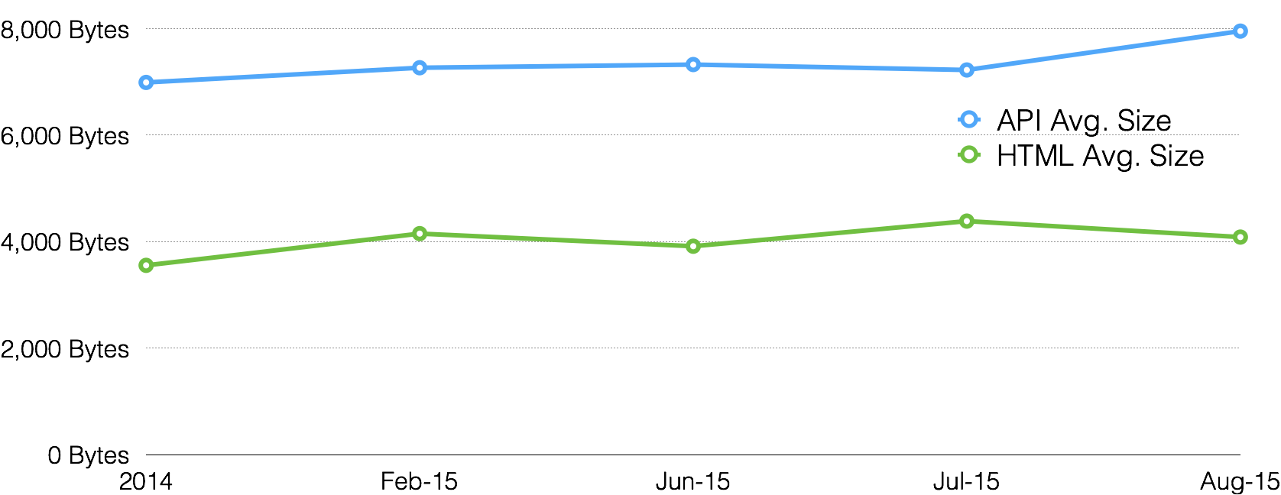
挑战 #4 : 频繁交互的API

Slide 28




对于业务的影响
新网站和应用的设计实现更困难
控制基础设施投资，改善投资回报
为购物季和促销做好准备
提升品牌形象和客户忠诚度

Slide 29
解决方案

Slide 30


方案 # 1 : Ion
任何时间，任何地点，任何设备的体验
降低传输时间
减少请求次数和内容
改善首屏时间
改善无线环境的可靠性和性能
改善总体体验

Slide 31







方案 # 2 : Image Converter
基于云的图片转换服务
Image Converter
JPEG
GIF
PNG
(In Beta)
Progressive JPEG
WebP
JPEG XR
JPEG 2000
Resize
Change quality
Crop
Change background
Combine images
Change output format

Slide 32
方案 # 3 : Cloudlets
简化应用开发，降低运维复杂度
Infrastructure
& Development
Operations
Digital Marketing Operations
Security &
Access Control
Mobile App &
API Support
Phased Release
Edge Redirector
IP/Geo Access
API Prioritization
Visitor Prioritization
Audience Segmentation
Forward Rewrite

Slide 33
方案 # 4 : 提升移动API性能
Akamai
针对有大量API调用的移动应用，提升性能和扩展性
加速交互
保证高峰时间的API可用性
灵活管理API流量
原站高负荷时，使用替代API响应
Ion and API Prioritization Cloudlet

Slide 34
☑
#1 性能决定一切：快！
☑
#2 移动就在眼前 : 响应式！
这是否足够？

Slide 35


普通汽车 vs 跑车
Track = Better Tyres
Bigger Brakes
Better Suspension
Bigger Engine + Turbo
Better Exhaust
Bigger Spoiler
Great city car

Slide 36
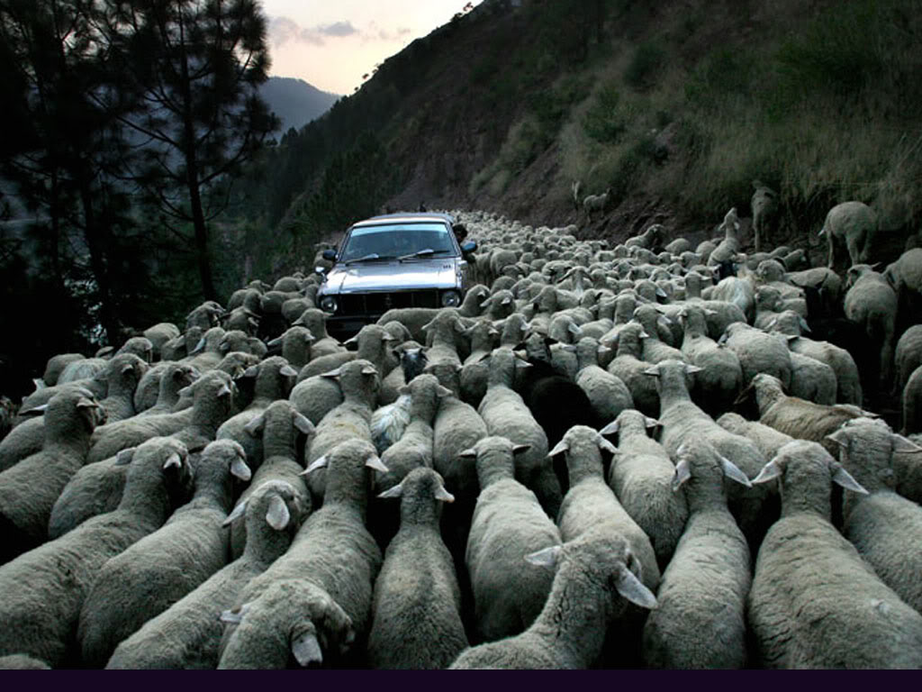
分布式拒绝服务攻击(DDoS)

Slide 37
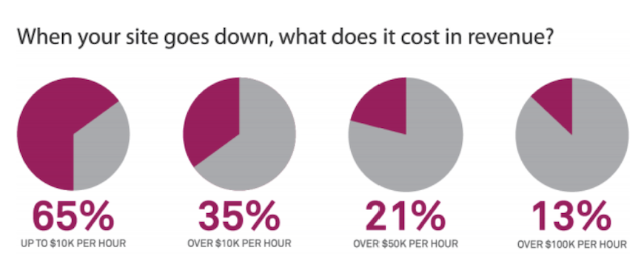
Notes:
http://mashable.com/2012/05/15/cost-of-a-cyberattack-100000-per-hour-for-most-retailers-report/ - DO WE HAVE NEWER STAT TO USE HERE NOT BASED ON ATTACKS
http://www.computerweekly.com/news/2240237932/Retail-technology-useless-without-back-end-support-says-John-Lewis
http://www.wired.com/2012/12/invest-in-uptime-to-avoid-the-nightmare-before-christmas/

Slide 38
客户案例

Slide 39

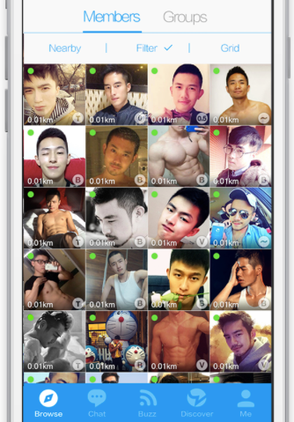
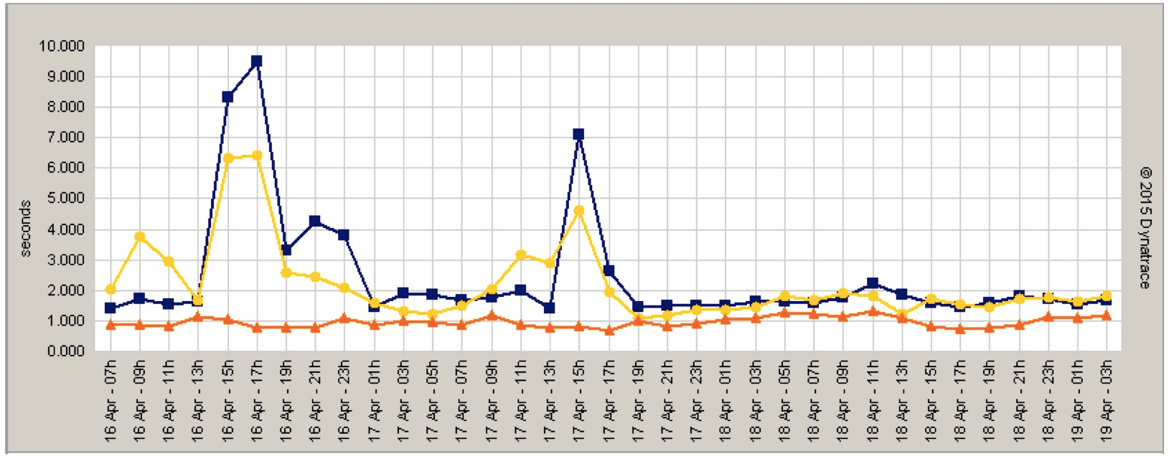

案例1: Ion帮助Blued提升移动应用API性能
153％
Faster API
Origin (207.226.xx.xx)
Origin (211.151.xx.xx)
Akamai (197.226.xx.xx)
Performance | Origin (207.226.xx.xx) | Origin (211.151.xx.xx) | Akamai | Akamai vs Origin (207.226.xx.xx) | Akamai vs Origin (211.151.xx.xx)
Global | 2.42 s | 2.19 s | 0.96 s | 153% | 129%

Slide 40

项目：响应式网站代替m站
案例2:
IMAGE
CONVERTER
目标
降低RWD页面加载时间
保证图片质量并适度裁剪压缩
减少人工图片处理
简化衍生内容的使用
结果
使用RWD + IC，2x提升移动转化率
将RWD页面缩减了1/2
适配Apple TV，Watch等新设备
Notes:
Similarly, Akamai has been leading the charge in helping simplify the task of optimizing and accelerating images for responsive web sites. The Gilt group used Akamai in their effort to replace an existing m.site and move to a responsive website. Using Image Convertor, they were able to dynamically optimize their images for mobile delivery and reduce page size by half in the process. The resulting improvement in site performance helped them improve their mobile conversions by 2x.

Slide 41
结论
性能决定一切,
移动就在眼前
&
安全不容妥协

Slide 42
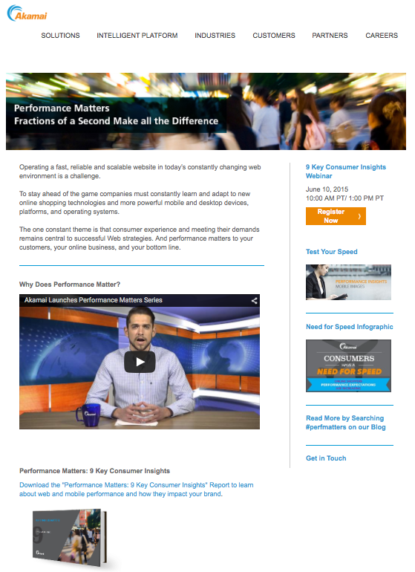
问题?
点击下方链接，获取更多信息和文档
www.akamai.com/perfmatters
下载报告
速度测试 —— 手机图片
浏览图文资讯
阅读博客文章

